Slide 1
Supply Chain Management Dashboard Introduction:-
This Supply Chain Report provides a detailed overview of supplier performance, product analytics, and overall supply chain efficiency. It highlights key metrics such as stock levels, profit margins, defect rates, and transportation costs across various segments.
The goal of this report is to support data-driven decisions that improve operational efficiency, reduce costs, and enhance customer satisfaction.

Slide 2
Project Problem Statement
Inconsistent supplier performance is leading to variability in profit margins and stock levels.
High defect rates across certain transportation modes impact product quality and customer satisfaction.
Transportation costs vary significantly by mode, affecting overall profitability.
Lack of centralized visibility into supplier, product, and logistics performance hinders strategic decision-making.
Current processes do not effectively highlight bottlenecks or inefficiencies in the supply chain.
The need exists for a data-driven dashboard to monitor key supply chain KPIs and enable proactive management.

Slide 3
Dataset Overview
The dataset used for this project contains detailed information on the makeup products supply chain, including:-
Product Type, SKU, Price Availability, Number of Product Sold, Revenue generated, Customer Demographics, Stock levels, Lead time, order quantities, Shipping times, Shipping carriers, Shipping Costs, Supplier Name, Location, Lead time, Production volumes, Manufacturing lead time, Manufacturing costs, Inspection results, Defect rates, transportation modes, routes, Costs.
These features will allow us to create dynamic visualization to explore product performance and supply chain efficiency, helping businesses optimize decision-making processes.

Slide 4
Techniques Used To Solve The Problem
Data preparation, cleaning & transformation :
Utilized Power BI and transform the raw data, ensuring consistency across key metrics like product sales, stock level, and shipping times.
Combined data from Excel sheets to create a comprehensive dataset, making it ready for analysis in Power BI report view.
Tools & technologies :
Power BI desktop for creating interactive dashboard and visualizations.
Excel for data modelling.

Slide 5
Visualization Techniques for Insights
Bar Charts – To compare revenue, stock levels, and supplier costs
Donut Charts – To show percentage distributions (e.g., defect rates, cost breakdowns, revenue by demographics)
Scatter Plots – To visualize the relationship between profit margin and defect rate by supplier
Column Charts – For analyzing order quantities across SKUs
Pie Charts – Used for quick insights into product type performance and demographics
KPI Cards – To highlight key metrics like revenue, product sold, and stock level
Interactive Filters – For SKU and supplier-level drill-down analysis

Slide 6
Interactive Dashboards for Enhanced Decision-Making
Provides a holistic view of supplier, product, and logistics performance
Highlights key metrics: revenue, stock levels, defect rates, and transportation costs
Identifies top-performing suppliers and high-demand products
Enables comparison of transportation modes based on cost and defect rates
Supports quick insights through interactive filters and KPI cards
Aids in detecting inefficiencies and cost-saving opportunities
Empowers data-driven decisions to optimize supply chain operations

Slide 7
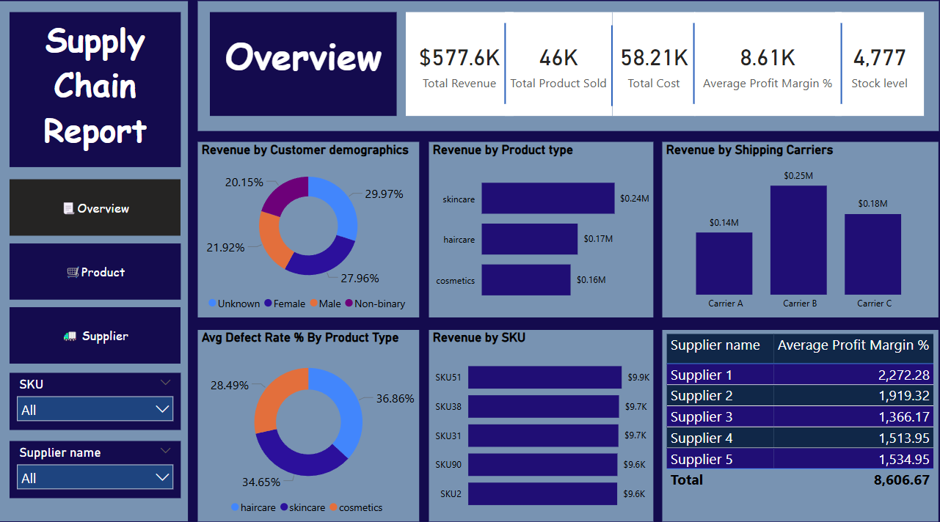

Slide 8
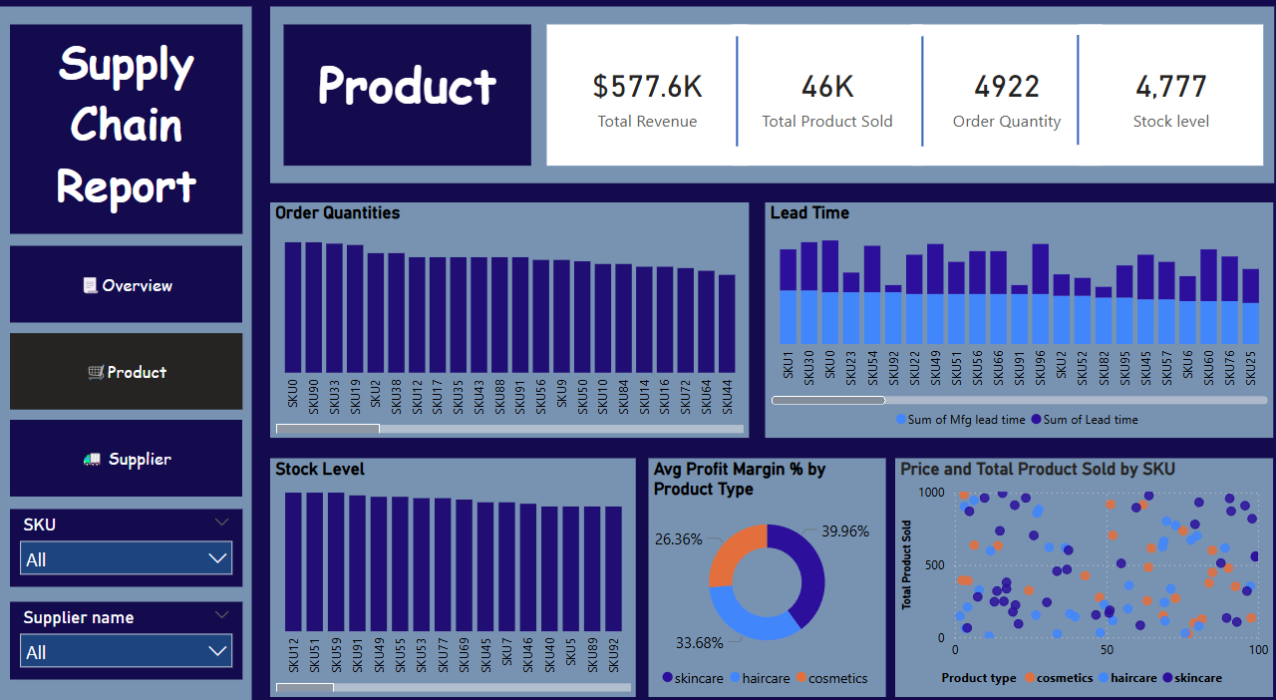

Slide 9
